Slide 1
Database Management Systems Project
Online Course Management Platform
Team Members
TEAM
Index Corruption
Ashutosh Sharma (23CS10005)
Sujal Anil Kaware (23CS30056)
Parag Mahadeo Chimankar (23CS10049)
Kshetrimayum Abo (23CS30029)
Kartik Pandey (23CS30026)

Slide 2







Schema Design - Overview
The database utilizes PostgreSQL as the core engine to store all academic data with a focus on Role-Based Access Control (RBAC).
Users & Auth
Academic Core
Handles app_user for authentication and executive profiles for system-wide analysts.
Normalized entities including University, Program, Course, Topic, and Textbook.
People & Roles
Operations
Specialized tables for Student, Instructor, Analyst entities linked via auth.
Tracks Enrollments, Assignments, and Course Proposals for new courses or topics.

Slide 3
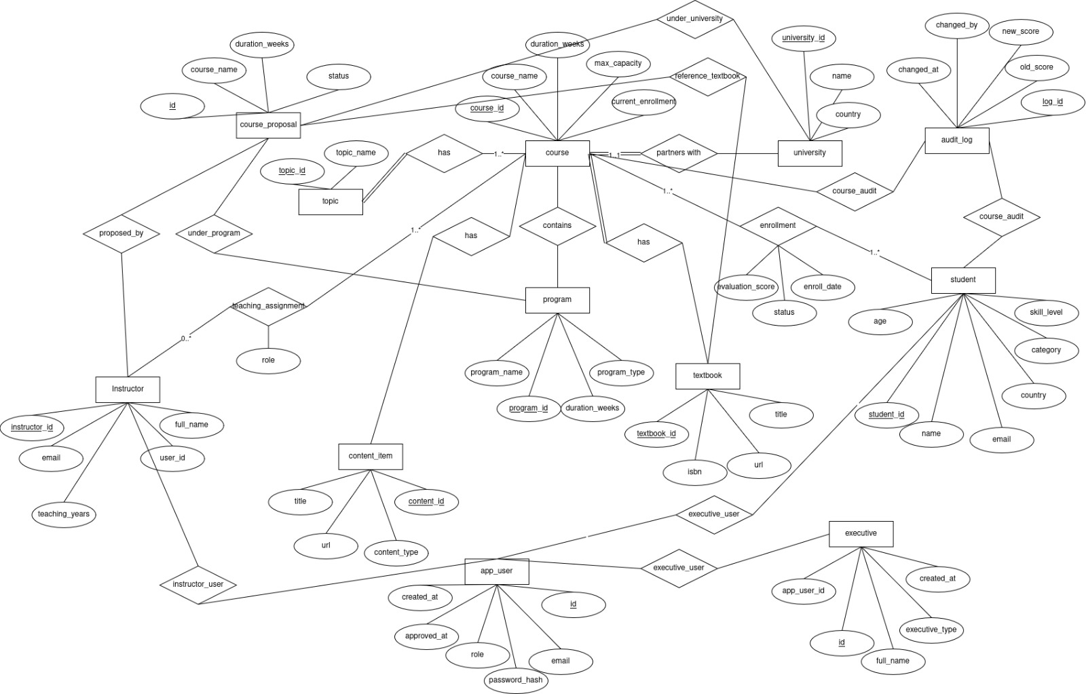
Schema Design - Relationships
Academic Hierarchy: Programs belong to Universities; Courses map to specific Programs.
Enrolment Workflow: Students link to Courses with Grade/Status tracking.
Instructional Mapping: Instructors are mapped to Courses via Assignment.
Content Association: Educational content (PDF/Video) is directly tied to specific Topics.
Governance: Audit logs capture sensitive grade changes for data integrity.

Slide 4






Technology Stack - Backend
Core Engine
Persistence
Security
Python 3.12+ with FastAPI for high-performance, asynchronous API execution.
PostgreSQL managed via SQLAlchemy 2.x ORM using the asyncpg driver.
Stateless JWT with python-jose and secure hashing via passlib (bcrypt).

Slide 5



Technology Stack - Frontend
Framework
UI & UX
Assets
Next.js 16 with App Router and TypeScript for enterprise-grade stability.
Tailwind CSS 4 & Radix UI for accessible, performant components.
Lucide React and Hugeicons for crisp, modern iconography.

Slide 6

Key Features - RBAC & Auth
4
Student:
Instructor:
Apply for courses and topics
View course materials, content, and assignments
Submit assignments
See Grades
Create courses and topics ( to be verified by admin)
Create and manage course content, and assignments
Grade assignments
Approve the student's course registration
View student progress and performance
DISTINCT ROLES
Analyst:
Access and analyze student performance data and Registration data
View courses and topics which are highly demanded by students
Admin:
Approve instructor and Analyst registration
Approve course and topic creation by instructors

Slide 7


User Modules: Interface & Functionality
Student Portal
Instructor Portal
Global course search and discovery.
Assignment management dashboard.
Seamless one-click enrollment process.
Content repository (Video/PDF uploads).
View academic credits and transcript history.
Formal Course/Topic proposal workflows.

Slide 8
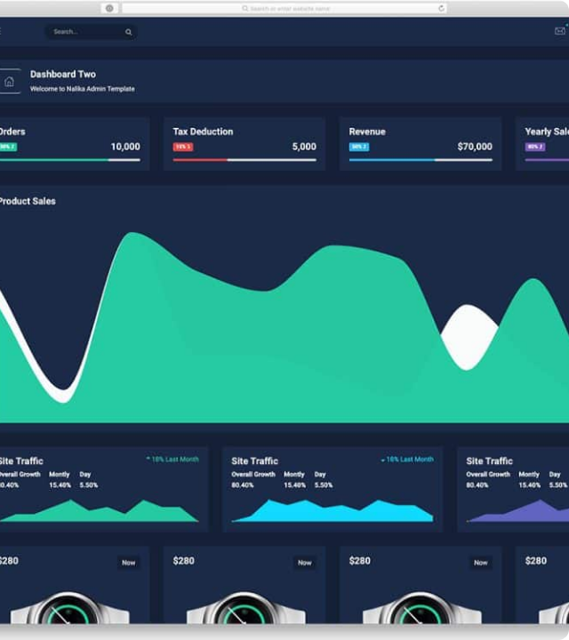
Admin & Analyst Hub
User Lifecycle: Auto-syncing of Student profiles upon creation.
Validation: Enforced business logic (Age limits/data integrity).
Analyst View: Real-time enrollment statistics and trending courses.
Maintenance: Cascading deletes for automated data cleanup.

Slide 9
Live Demonstration
Thank you for your attention!
GROUP: INDEX CORRUPTION | 2026

